Slide 1





FIFA Data Analytics And Visualization

Slide 2
Project made by :
Lamiss gargouri
2105789

Slide 3


1.
About FIFA

Slide 4
FIFA 21 is a FIFA series association football simulation video game produced by Electronic Arts. It is the 28th entry in the FIFA series, and it was launched on Microsoft Windows, Nintendo Switch, PlayStation 4, and Xbox One on October 9, 2020. On December 3, 2020, enhanced versions for the PlayStation 5 and Xbox Series X and Series S were published, as well as a Stadia version in March 2021.
This data visualization will employ statistics information from football players who appear in the game FIFA 21, which has been updated for the 2020-2021 season. We will utilize the dataset provided on Kaggle for our data visualization, which comprises information on 18+ players with 100+ attributes taken from the most recent edition of FIFA.

Slide 5








Big concept

Slide 6
Let’s review some concepts
Big Data
is a combination of technologies for storing, analyzing, and managing large amounts of data, as well as a macro-tool for seeing patterns in the chaos of this information explosion in order to construct smart solutions.
Data Analytics
Is the science of studying raw data in order to draw conclusions about it.
Data analytics techniques and procedures have been turned into mechanical processes and algorithms that operate on raw data for human consumption. A company's performance may be improved by using data analytics.
Data Visualization
Data visualization software may be utilized in a number of different ways. The most prevalent application nowadays is as a reporting tool for business intelligence (BI).
By visualizing data in the form of maps or graphs, we can have a better understanding of what it implies. This makes the data easier to interpret for the human mind, making it easier to see trends, patterns, and outliers in vast data sets.

Slide 7
2. Dataset

Slide 8
Context
The ideal budget for building a competitive team (at the level of Europe's top n teams) in which the budget does not allow for the purchase of much superior players for the 11-man lineup. An extra is a comparison of the lineup's Potential attribute rather than the Overall attribute.
Comparison between two players (In comparison to real-life numbers, which skill qualities changed the most over time).
Sample analysis of the top n percent players to evaluate if some key traits like agility, ball control, and strength have remained popular or not over FIFA editions. For example, in FIFA 20, the top 5% of players are faster (better Acceleration and Agility) than in FIFA 15. The trend of qualities is also a good indicator of how crucial specific attributes are for players to win games.
Content
Every player in FIFA 15, 16, 17, 18, 19, 20, and FIFA 21 is accessible.
100+ attributes
The scraped players' URLs
Positions of players, as well as their roles in the club and the national team.
Attacking, Skills, Defense, Mentality, GK Skills, and so on are all player traits with statistics.
Nationality, Club, DateOfBirth, Wage, Salary, and other personal information about players are collected.

Slide 9
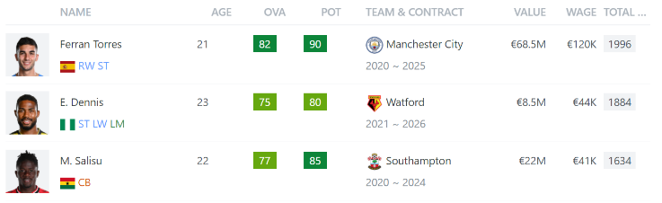

Slide 10
3. Analysis And Visualization

Slide 11
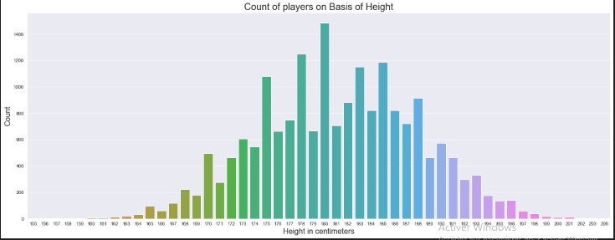
Count of Players on basis of height

Slide 12
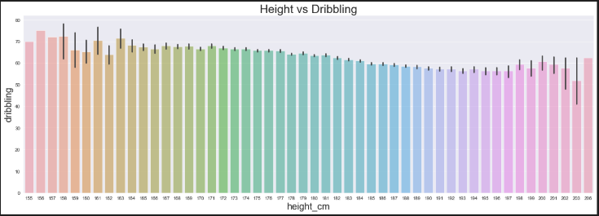
Height Vs Dribbling
➔ Dribbling is not affected by height

Slide 13
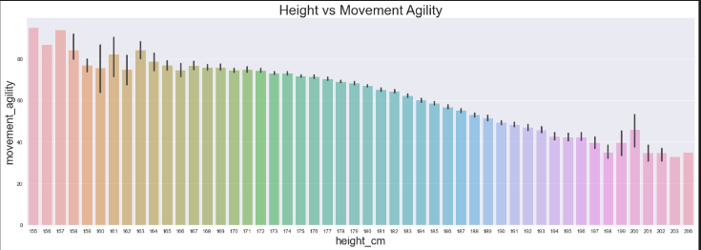
Height Vs Movement Agility
➔ Height does affect movement agility

Slide 14
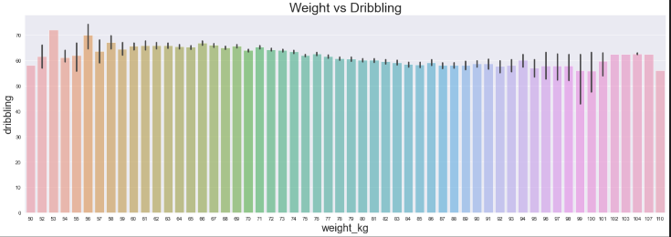
Weight Vs Dribbling
➔ Weight does not affect Dribbling

Slide 15
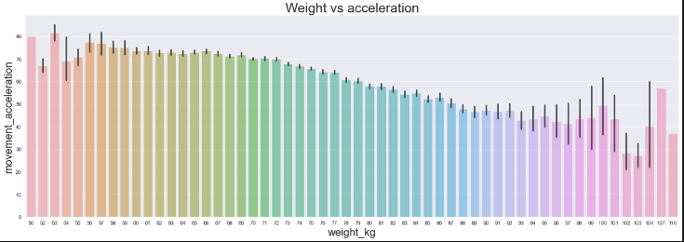
Weight Vs Acceleration
➔ Weight does affect acceleration

Slide 16
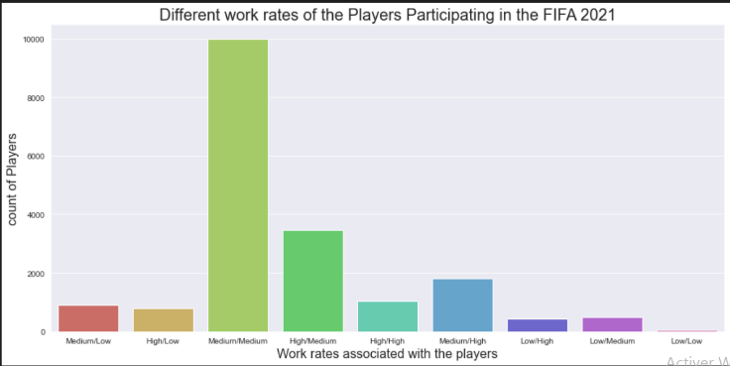
Different work rates of the Players Participating in the FIFA 2021

Slide 17
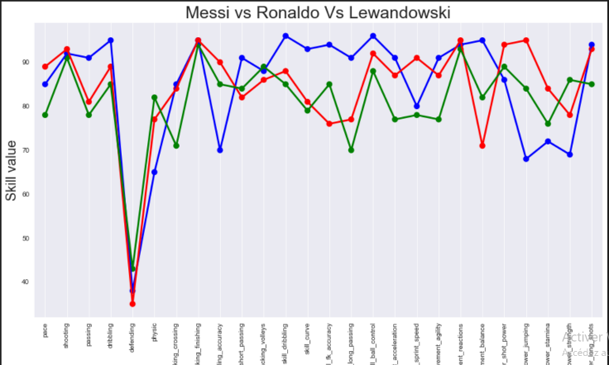
Comparing Stats of Messi, Lewandowski & CR7

Slide 18
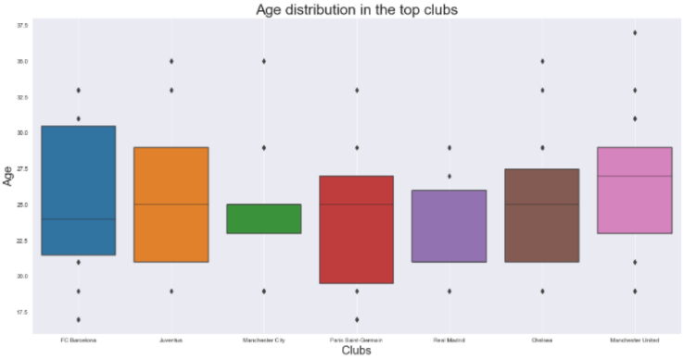
Age distribution in the Top Clubs
➔ we can deduce the strategy of each club through this chart. For instance PSG is clearly the one who is investing the most in its academy while Manchester City is clearlytaking only initiated player from the age of 22.5 to 25 (at their prime).

Slide 19
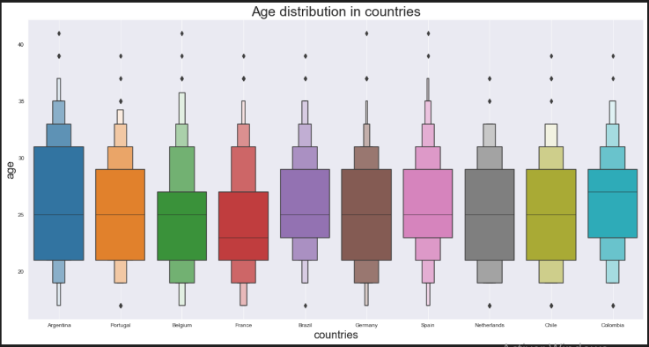
Age distribution of Players in Countries
➔As expected, the age distribution between countries is similar.

Slide 20

Thanks!

